Slide 1
VG100 Lab 8
Common Mistakes of Spcaing, Tables & References
Xiong ZIYANG
2023.7.5

Slide 2

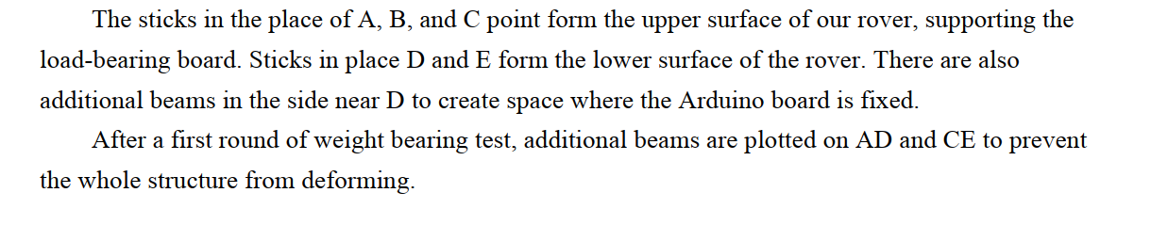
Basic
• Justify align !
• No space is required at the beginning of the paragraph!

Slide 3
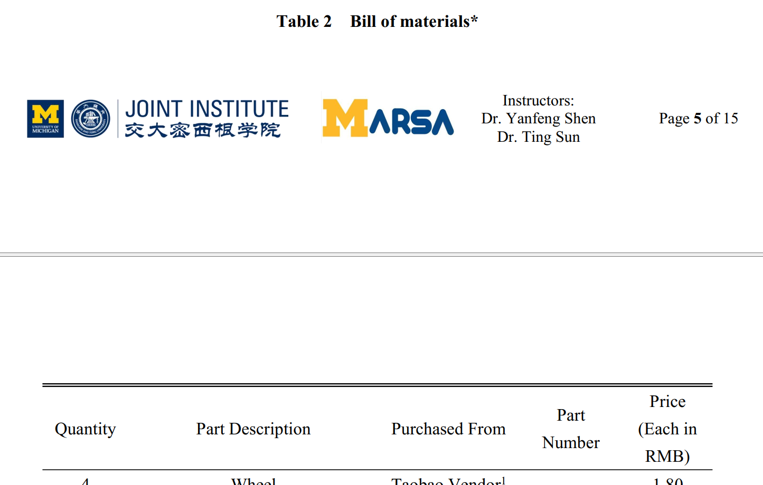
Basic
• Justify align !
• No space is required at the beginning of the paragraph!
• Do not split the tables!

Slide 4
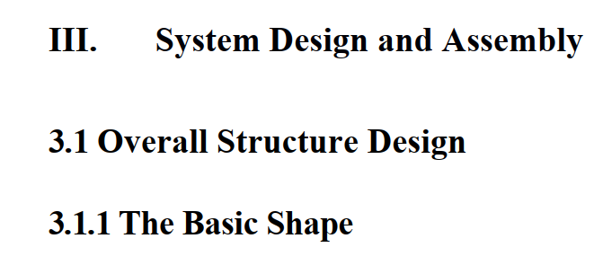
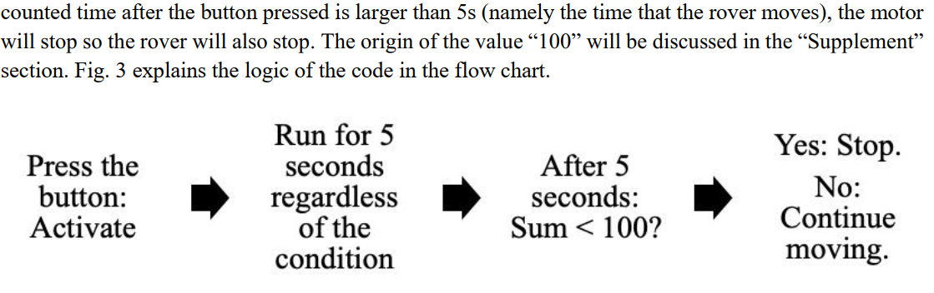
Font
• Font size (subtitle > body)
• All requirements apply for text in your figures

Slide 5
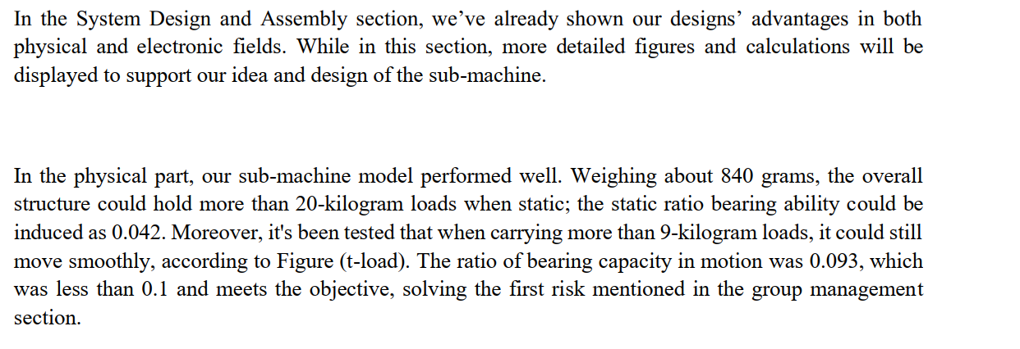
Spacing
• Spacing for text

Slide 6
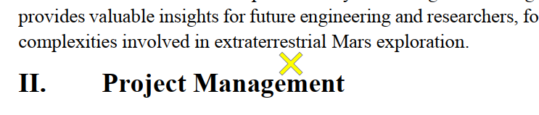
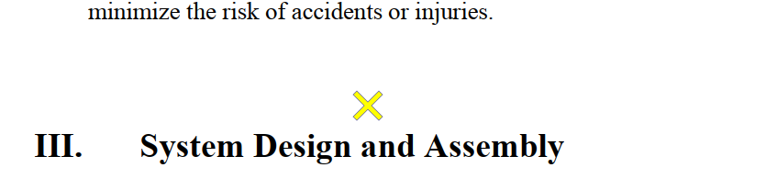
Spacing
• Spacing for text
• Spacing between sections

Slide 7
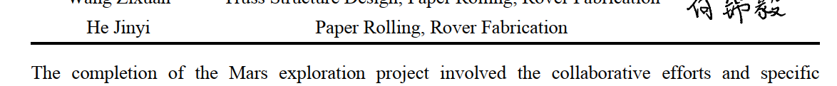
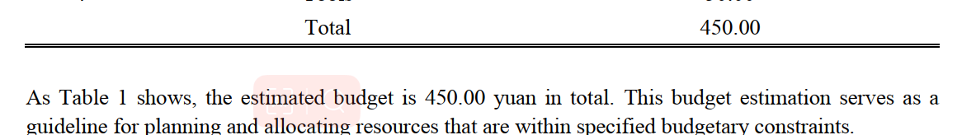
Spacing
• Spacing for text
• Spacing between text and subtitles
• Spacing between caption and text/figures/tables

Slide 8
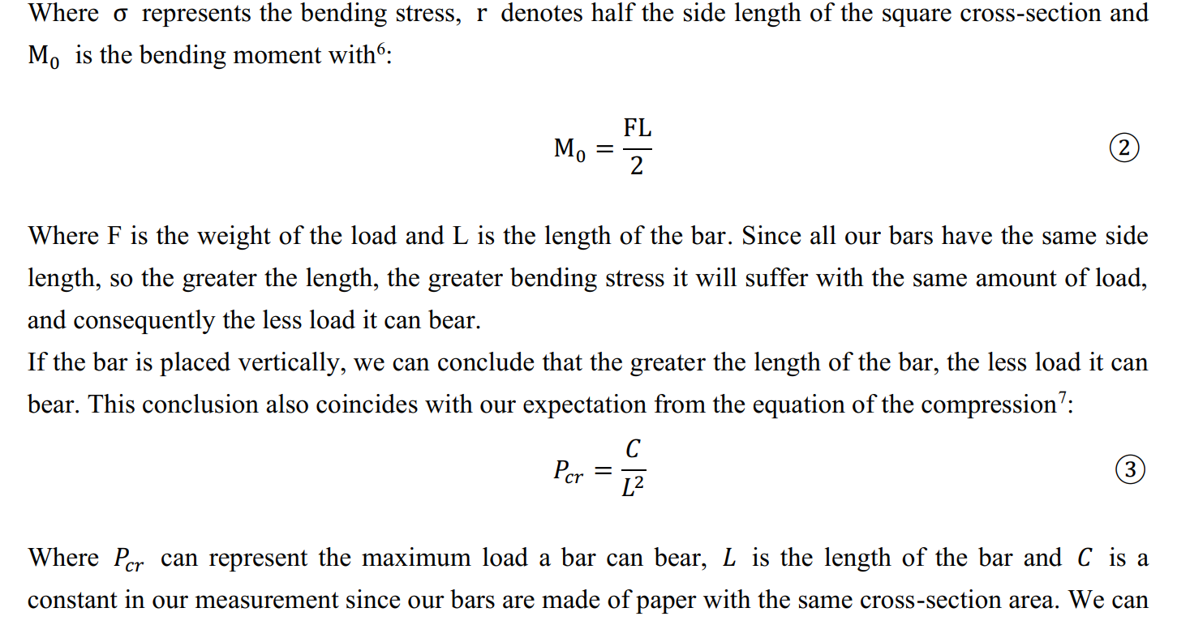
Spacing
• Spacing for text
• Spacing between text and subtitles
• Spacing between caption and text/figures/tables

Slide 9
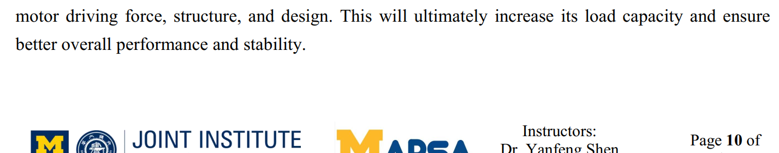
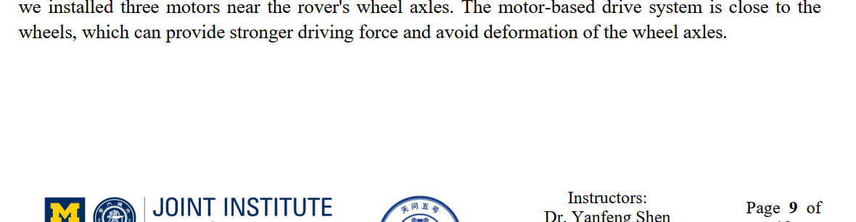
Spacing
• Spacing for text
• Spacing between text and subtitles
• Spacing between caption and text/figures/tables
• “Jammed” / space too much last line

Slide 10
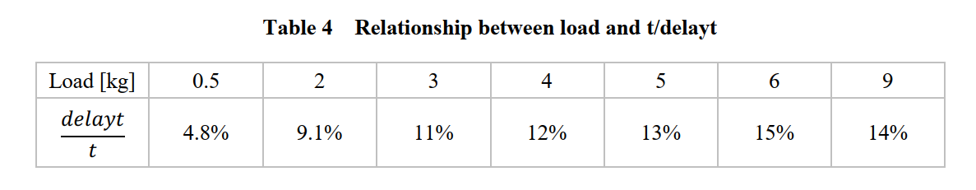
Table
• No background color
• No lines
• Three-line Table

Slide 11
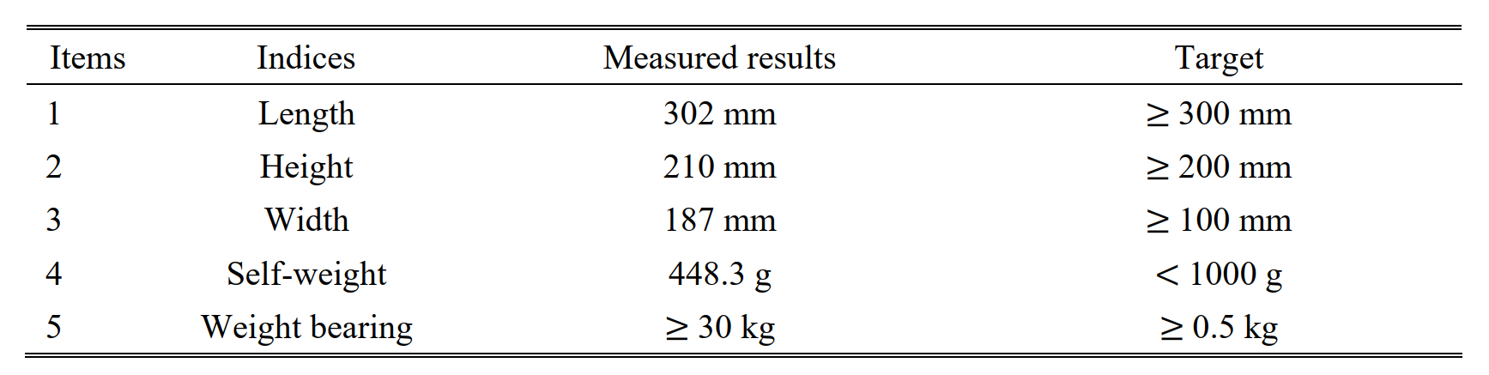
Table
• No background color
• No lines
• Three-line Table

Slide 12
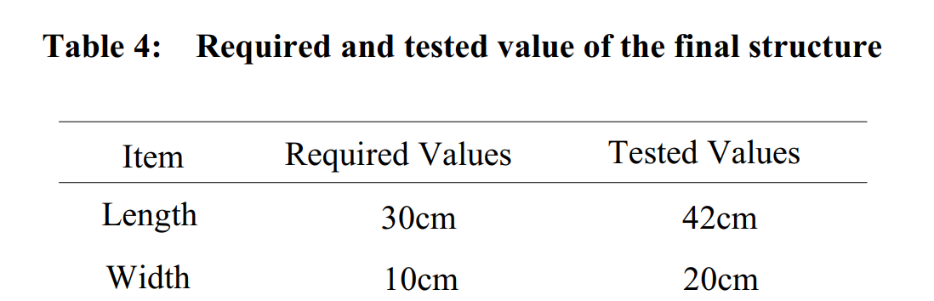
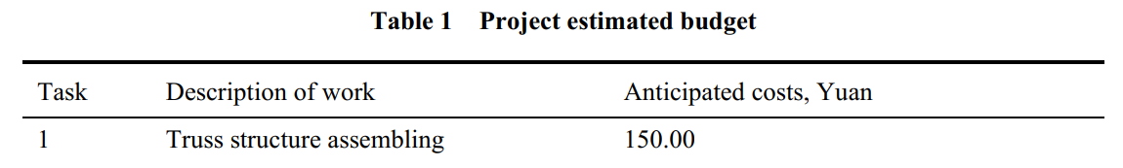
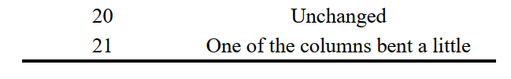
Table
• No background color
• No lines
• Three-line Table

Slide 13
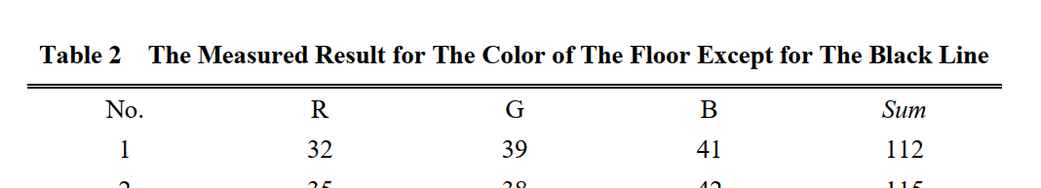
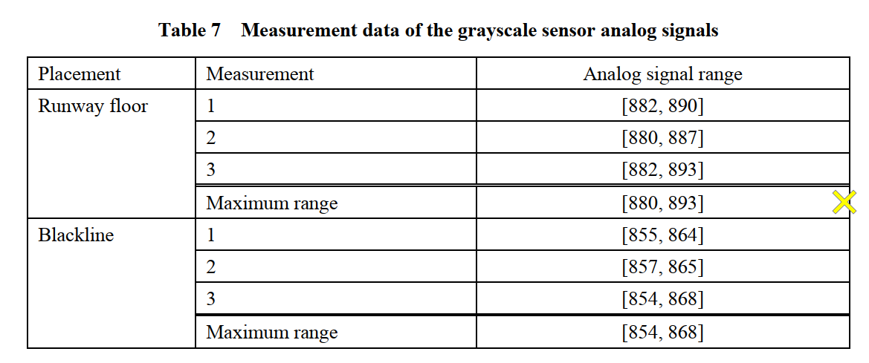
Table
• No background color
• No lines
• Three-line Table

Slide 14
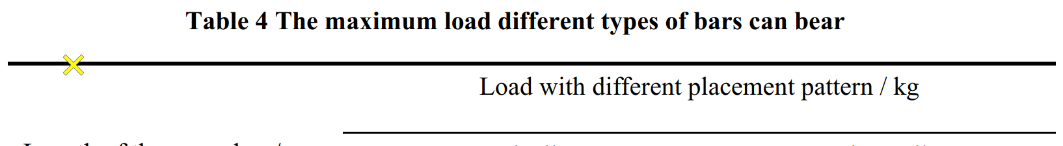
Table
• No background color
• No lines
• Three-line Table
• Spacing after the caption
• Table naming format
Table+space+1+tab+capitalize

Slide 15
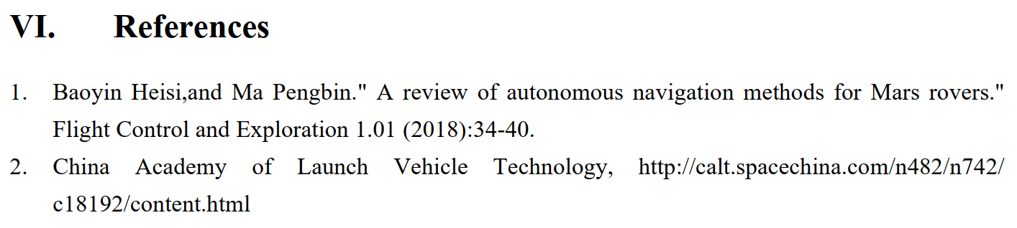
Reference (AIAA)
• All references should be in 9-point font
• With reference numbers in square brackets
• [1] ......

Slide 16
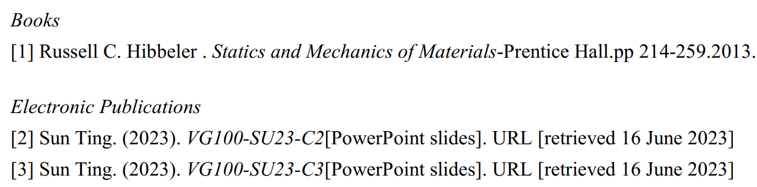
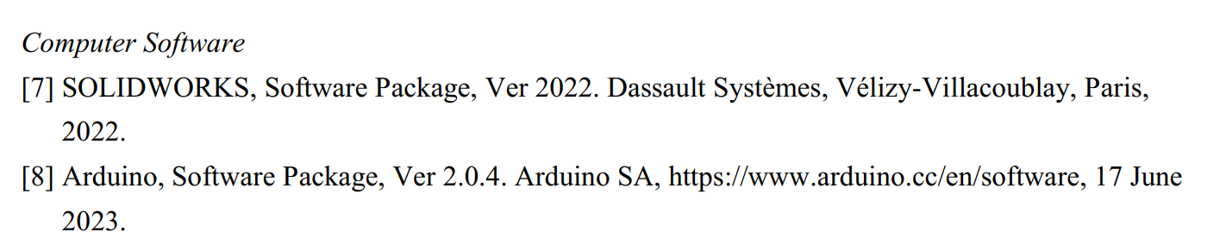
Reference (AIAA)
• All references should be in 9-point font
• With reference numbers in brackets.
• [1] ......
• Not indicate the type of reference

Slide 17
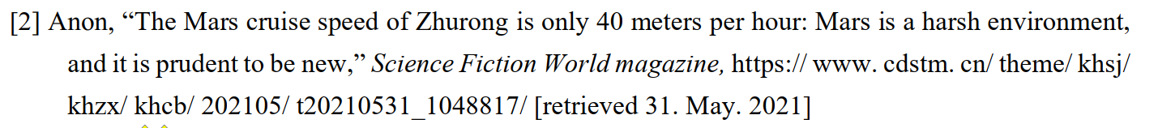
Reference (AIAA)
• All references should be in 9-point font
• With reference numbers in brackets.
• [1] ......
• Not indicate the type of reference
• “xxxx,” (comma in quotation mark)
• Vol. xx, No. xx (Capital letter)
• xxxxxxxxxx. (period at the very end)

Slide 18
Reference (AIAA)

Slide 19
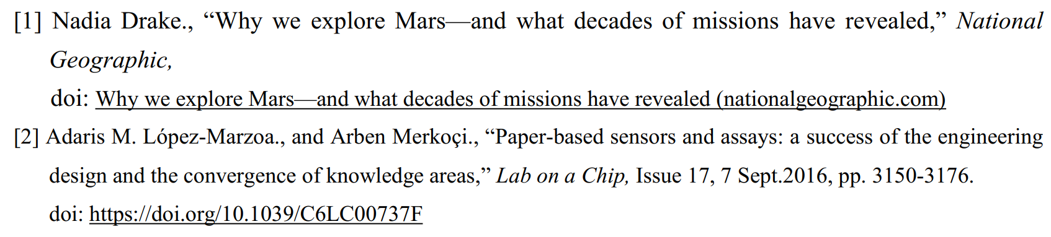
Reference (AIAA)

Slide 20
References
Bai, Xiaoyan, Sun, Haojia, VG100 Lab3 TC, 2022.

